Slide 1

Dodge Falling Blocks 3D
A Single-File 3D Arcade Game
[Nithin kumar and team]

Slide 2



Key Features of Dodge Falling Blocks 3D
01
Responsive Design
02
Real-time 3D Rendering
03
Scoringand Power-ups
The game adapts seamlessly to various screen sizes for optimal play.
Utilizing Three.js, the game provides smooth, immersive graphics and animations.
Players can earn points and discover power-ups to enhance gameplay dynamics.

Slide 3


PORPOSE AND SCOPE OF PROJECT
The aim of Dodge Falling Blocks 3D is to showcase web development skills by integrating 3D graphics, physics, and user interfaces into a single HTML file. This project demonstrates how complex game mechanics can be effectively implemented while maintaining a clean and efficient code structure.

Slide 4


Overview of System Architecture
Understanding the client-side architecture of Dodge Falling Blocks 3D
The single-page architecture of Dodge Falling Blocks 3D allows for streamlined performance. This design integrates HTML, CSS, and JavaScript into a cohesive unit. By leveraging tools like Three.js, the game achieves real-time rendering while keeping the file structure efficient and manageable, ensuring smooth gameplay and user experience.

Slide 5

Essential specifications for optimal gameplay experience
To run Dodge Falling Blocks 3D effectively, users must ensure their systems meet the following hardware and software requirements:
Multi-core CPU: A powerful processor is necessary for seamless gameplay and smooth performance.
WebGL-enabled graphics: This allows for advanced graphics rendering essential for the 3D experience.
4GB RAM minimum: Adequate memory is crucial to handle real-time data processing during gameplay.
Modern Operating Systems: Compatible with Windows, macOS, or Linux distributions.
Supported Browsers: Up-to-date versions of Chrome, Firefox, Safari, or Edge are required for optimal compatibility.
Internet Connection: A stable connection is needed for loading additional libraries and assets.
Ensuring these specifications will enhance the overall gaming experience, making it engaging and enjoyable for players. With the right setup, users can fully immerse themselves in the dynamic and fast-paced world of Dodge Falling Blocks 3D.

Slide 6

Setting Up the Three.js Scene
Understanding the foundational elements for gameplay design The Three.js scene setup involves crucial components like the
camera, lighting, and meshes. These elements create the
environment for the player, obstacles, and power-ups. Proper
configuration ensures a smooth rendering experience, allowing for
engaging gameplay and visual clarity throughout the arcade game.

Slide 7



Game Logic Modules Overview in Dodge Falling Blocks 3D
Obstacles Class Mechanics
PowerUps Class Effects
Player Class Functionality
The PowerUps class introduces temporary boosts to gameplay. Players can collect power-ups that provide effects like shields for protection or slow-motion for easier navigation through obstacles. This adds strategic elements to the game, allowing players to adapt their tactics effectively.
The Player class manages the character's movement and actions. It includes attributes for velocity and states like shield and shrink, allowing for dynamic gameplay experiences. Players can navigate through obstacles while adjusting their speed and defensive capabilities.
The Obstacles class is responsible for generating and managing falling blocks. It handles spawning patterns, speed variations, and difficulty scaling as the game progresses. This ensures that players face increasingly challenging scenarios, enhancing engagement and excitement.

Slide 8
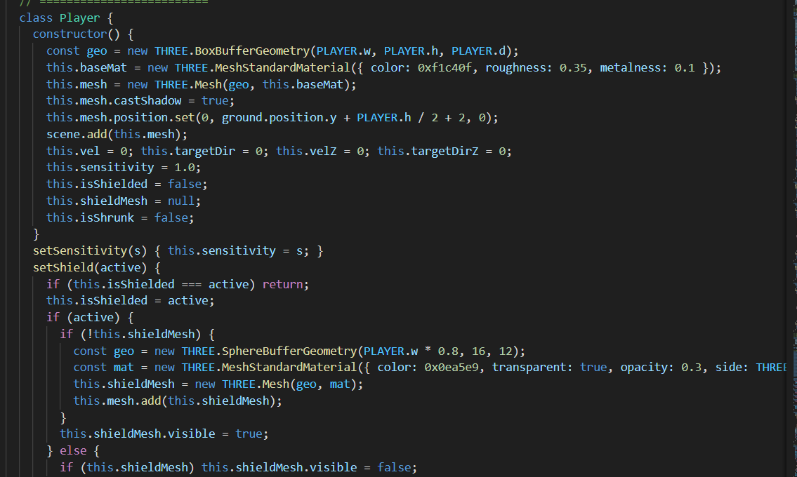
Player class functionality

Slide 9
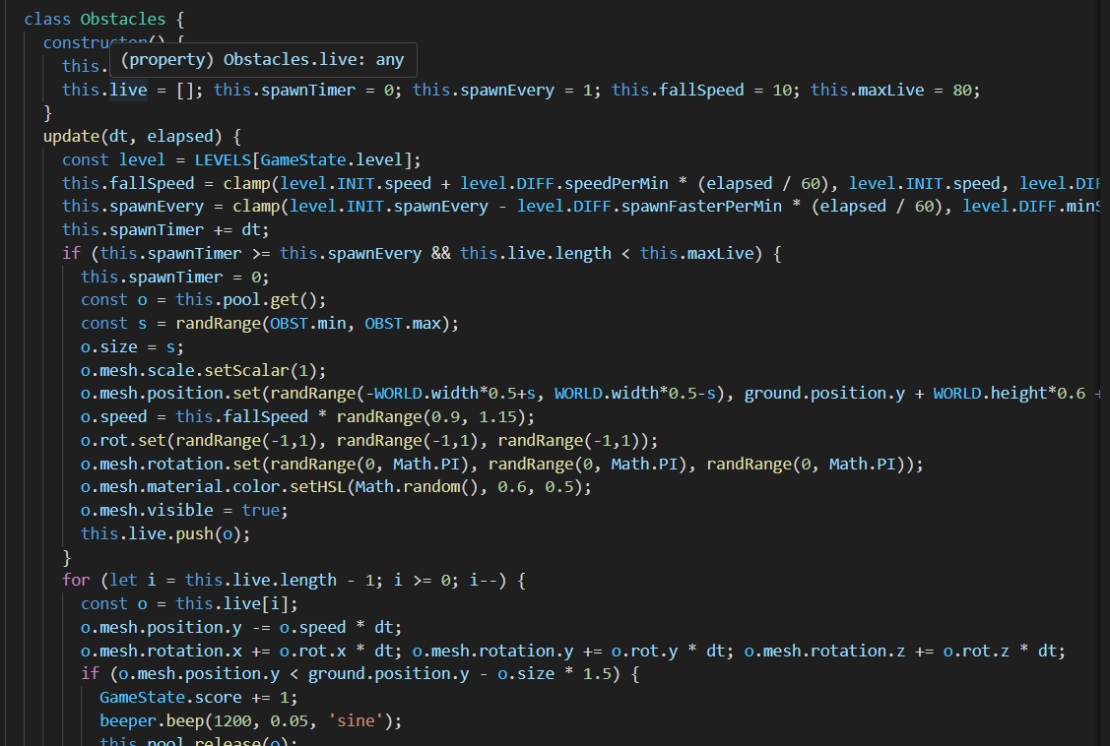
Obstacle class mechanics

Slide 10
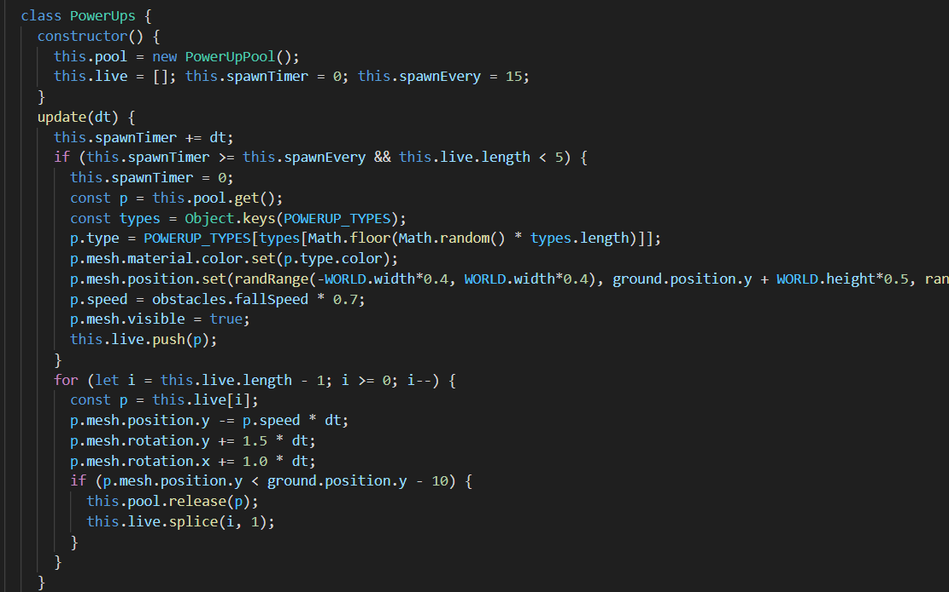
Power ups Class Effects

Slide 11

Main renderLoop Function Steps in Gameplay
Calculate delta time
Update game objects
Collision detection
This measures the time between frames for smooth animations.
All game entities are repositioned based on player inputs and physics.
This checks for interactions between the player and obstacles or power-ups.
Render scene update
Optimize rendering performance
Manage game states
This tracks current gameplay conditions, pausing and resuming as needed.
The final scene is drawn to the canvas for visual output.
Efficient rendering ensures a consistent frame rate and responsive gameplay.

Slide 12
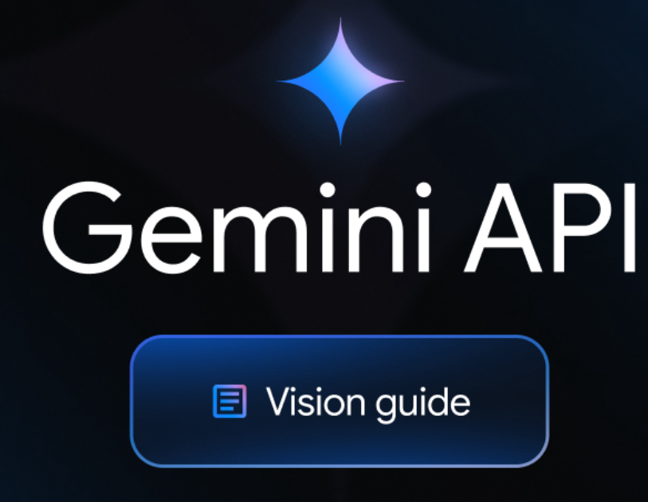
Enhancing Gameplay with AI Integration
Utilizing the Gemini API for personalized player experiences
The Gemini API enhances gameplay by providing a unique AI Coach feature, offering personalized gameplay tips after a game pause or over. Additionally, the Dream a Theme tool creates visually appealing color schemes that elevate the game's atmosphere, enhancing player engagement and immersion in the 3D arcade environment.

Slide 13
The Dodge Falling Blocks 3D project demonstrates several critical aspects of modern web development:
Minimal File Structure: The game is built as a single-page application, showcasing how to efficiently manage resources within a compact setup. This approach emphasizes modular thinking and highlights the potential for streamlined code implementation. Advanced 3D Graphics: Utilizing Three.js for rendering, the project integrates complex 3D visual elements and physics into a browser environment. This incorporation of graphics showcases the capabilities of modern browsers to handle rich media experiences, pushing the boundaries of traditional web applications. AI-Powered Interactivity: The integration of the Gemini API adds a layer of dynamic user engagement, allowing for personalized experiences through features like the AI Coach. This demonstrates how artificial intelligence can enhance gameplay and provide users with tailored feedback and aesthetics.
Overall, this project serves as a comprehensive example of how to blend creativity and technical skills, providing insights into the potential of web technologies in creating immersive gaming experiences.

Slide 14
Overview of Game Output Screens
01
02
EngagingGameplay Experience
03
Main Menu Features
GameOverScreen Insights
The Main Menu offers options for starting the game, continuing, and learning how to play.
Gameplay showcases a dynamic 3D environment with player movements, obstacles, and power-ups visible.
The Game Over screen displays the final score and best score along with AI- generated tips.

Slide 15
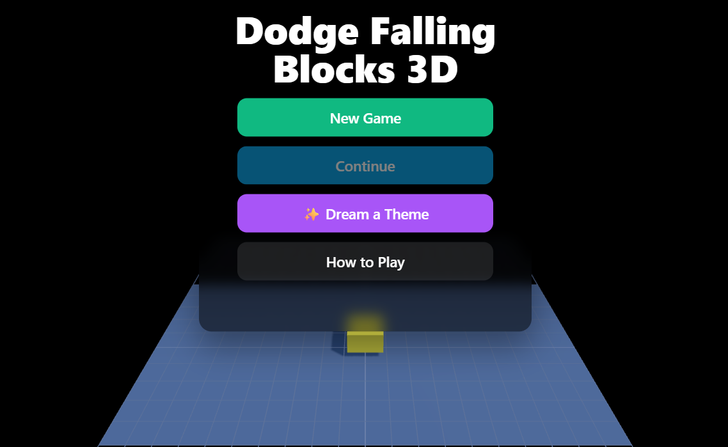
MAIN MENU
SCREEN
The main menu is the first screen the user
sees. It presents options to start a new
game, continue a saved game, learn how to
play, or generate a new theme using the
AI feature.

Slide 16
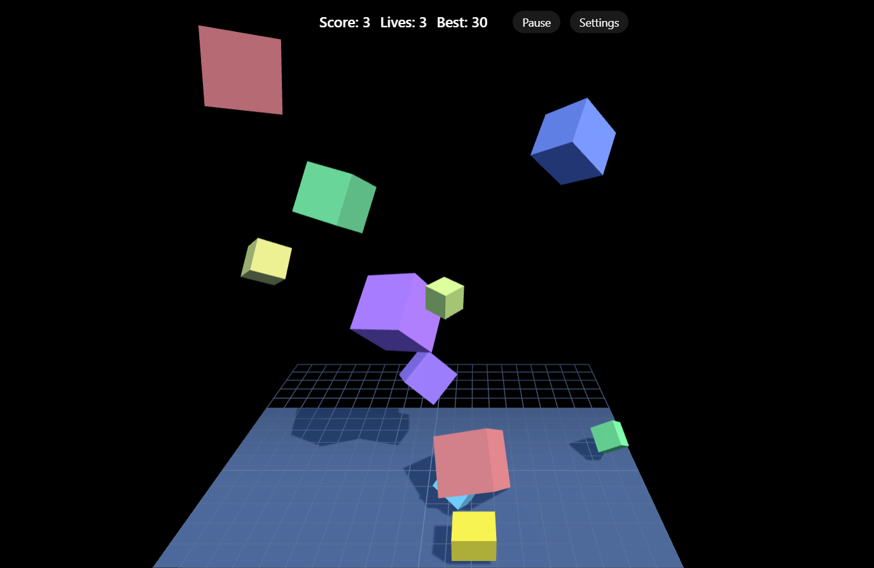
GAME PLAY
SCREEN
This is the core gameplay screen. It
shows the 3D environment with the
player, falling blocks, and power-ups.
The HUD is visible at the top,
displaying the current score and
remaining lives.

Slide 17
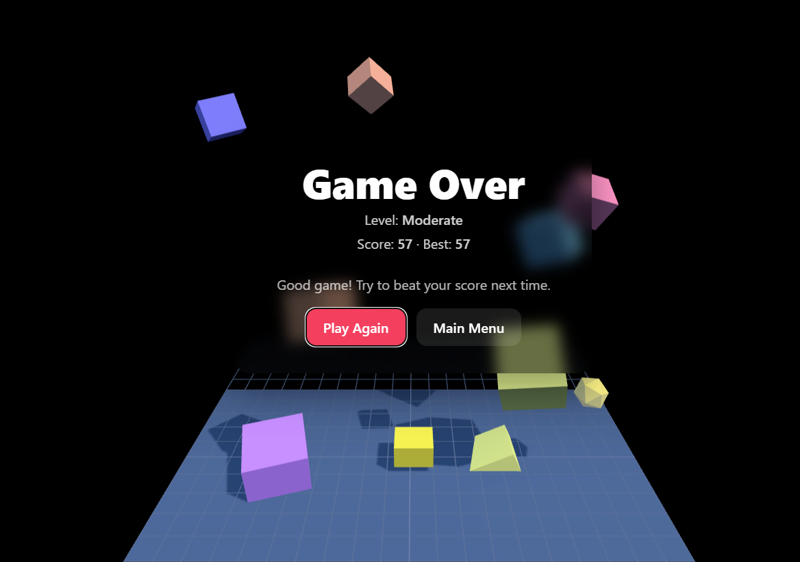
GANE OVER
SCREEN
This screen appears when the player's lives run out. It displays the final score, the best score, and a personalized tip from the AI coach.

Slide 18

Thank you for your attention!
Feel free to reach out for more information or any questions about Dodge Falling Blocks 3D.
Email Address
gudabandinithinkumar@gmail.com
Phone Number
+91 7995813329

